Slide 1
Unit 5 Bayesian statistics

Slide 2
Background information
Bayesian statistics is a theory in the field of statistics based on the Bayesian interpretation of probability where probability expresses a degree of belief in an event. The degree of belief may be based on prior knowledge about the event, such as the results of previous experiments, or on personal beliefs about the event. This differs from a number of other interpretations of probability, such as the frequentist interpretation that views probability as the limit of the relative frequency of an event after many trials
Bayesian statistical methods use Bayes' theorem to compute and update probabilities after obtaining new data. Bayes' theorem describes the conditional probability of an event based on data as well as prior information or beliefs about the event or conditions related to the event ^{[2][3]} For example, in Bayesian inference, Bayes' theorem can be used to estimate the parameters of a probability distribution or statistical model. Since Bayesian statistics treats probability as a degree of belief, Bayes' theorem can directly assign a probability distribution that quantifies the belief to the parameter or set of parameters
With the advent of powerful computers and new algorithms like Markov chain Monte Carlo, Bayesian methods have seen increasing use within statistics in the 21st century

Slide 3
Continued
Bayesian inference refers to statistical inference where uncertainty in inferences is quantified using probability. In classical frequentist inference, model parameters and hypotheses are considered to be fixed. Probabilities are not assigned to parameters or hypotheses in frequentist inference. For example, it would not make sense in frequentist inference to directly assign a probability to an event that can only happen once, such as the result of the next flip of a fair coin. However, it would make sense to state that the proportion of heads approaches one-half as the number of coin flips increases.^{[7]}
Statistical models specify a set of statistical assumptions and processes that represent how the sample data is generated. Statistical models have a number of parameters that can be modified. For example, a coin can be represented as samples from a Bernoulli distribution, which models two possible outcomes. The Bernoulli distribution has a single parameter equal to the probability of one outcome, which in most cases is the probability of landing on heads. Devising a good model for the data is central in Bayesian inference. In most cases, models only approximate the true process, and may not take into account certain factors influencing the data.^{[1]} In Bayesian inference, probabilities can be assigned to model parameters. Parameters can be represented as random variables. Bayesian inference uses Bayes' theorem to update probabilities after more evidence is obtained or known
The formulation of statistical models using Bayesian statistics has the identifying feature of requiring the specification of prior distributions for any unknown parameters. Indeed, parameters of prior distributions may themselves have prior distributions, leading to Bayesian hierarchical modeling,^{[9]} or may be interrelated, leading to Bayesian networks

Slide 4
Objectives
Bayesian statistics is the most effective when we have a lot of background knowledge about phenomenon (previous knowledge/experience, laws of physics
At the end of this lecture, you will be able to do the following:
Describe the Bayesian approach to statistical decision making.
Explain the mechanisms of the Bayesian approach, particularly the prior and posterior beliefs .
Understand the role and significance of the prior distribution in a Bayesian set-up.
Identify the Beta distribution and its role in Bayesian statistics as a prior distribution on a one-dimensional parameter.

Slide 5
Introduction to the Bayesian Framework
No need to know a lot of tests, just prior, likelihood and posterior, but computationally more intensive
Earlier things we did were based on frequentist perspective (hypothesis tests, confidence intervals), like what will happen if we will do this experiment many times
In Bayesian framework, it can be about process that happens once, not a lot of times
It enables to incorporate a lot of prior knowledge
For Bayesian the extra thing we need to add is prior distribution, it is capturing our prior beliefs on what parameters should actually be
Once we have our prior, we are going to try to update it after we use data into a posterior
But if we do have much prior info, it is good use improper priors or noninformative priors
Those are priors that allow us to use Bayesian machinery without actually having prior belief

Slide 6
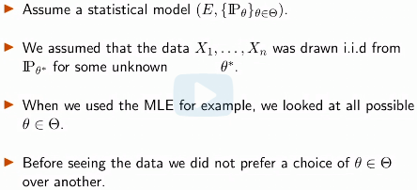
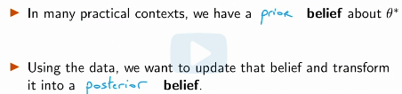
Goals
Bayesian approach is an alternative to frequentist approach
New concepts
prior and posterior distributions
Bayes’ formula
Improper, non informative priors
Bayesian estimation: posterior mean, maximum a posteriori (MAP)
Bayesian confidence region
In a sense, Bayesian inference amounts to having a likelihood function Ln(theta) that is weighted by prior knowledge on what theta might be (useful for many applications)

Slide 7
Frequentist vs. Bayesian
The first choice "In Bayesian statistics, the true parameter is modeled as a random variable, or at the very least, the uncertainty regarding the true parameter is modelled as such" is correct. In the Bayesian set-up, we model the true parameter as a random variable and update its distribution as we receive more data.
The second choice "In most practical applications of Bayesian statistics, we are trying to estimate the true parameter as accurately as possible as possible only from the observation data and our chosen model." is incorrect. In the Bayesian set-up, we do not even assume that there exists a true parameter, or at least we model it as a random variable to represent our uncertainty. This is rather the approach of frequentist statistics.
The third choice "In Bayesian statistics, we use the data to update our prior belief about a parameter and transform it into a posterior belief, which is reflected by a posterior distribution." is correct. Our prior belief is captured by the prior distribution on the parameter, and we can use Bayes' formula to update the prior distribution as we receive more data.
Ways to incorporate our existing knowledge in frequentist approach 1) limit the set of possible values for parameter 2) choose more suitable probability model 3) choose more suitable procedure MLE, M-estimation or method of moments

Slide 8
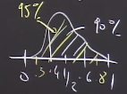
Example of the Bayesian approach- Kiss example
Let p be the proportion of couples that turn their head to the right
Let X1…Xn be iid Ber(p)
In the frequentist approach, we estimated p (using MLE), we constructed some CI for p and we did hypothesis testing, e.g. H0: p=0.5 vs H1 p!=0.5
Before analyzing the data, we may believe that p is likely to be close to 0.5
The Bayesian approach is a tool to update our prior belief using the data
If before analyzing data we believe that p is close to 0.5, Bayesian approach allows us to take this into account (say also we believe P(p<0.25 or p>0.75)<0.01
Thus, we treat p as random variable with distribution that matches
Our prior belief and belief about p can be quantified
So, we model our prior belief using a distrib for p, as if p was random
In reality, the true param is not random, however, Bayesian approach
Is a way of modeling our belief about parameter by doing as if it was random

Slide 9
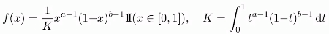
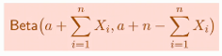
Example of Bayesian approach; beta-distribution
If we are modeling Ber(p) distribution we can use p ~ Beta (a,b) which has pdf which is positive only in interval [0,1]
K is normaliz. Factor
Every time you are going to have a Bernoulli distribution it is very likely we are going to pick up a beta prior because they are flexible (by tweaking a and b)
In our experiment X1…Xn are assumed to be iid Ber with parameter p conditioned on our prior belief
After observing the available sample X1…Xn we can update our belief about p by taking its distribution conditionally on the data, then we get what we call posterior distribution for p
For beta distribution posterior has the form

Slide 10
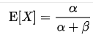
Some useful information
In Bayesian probability theory, if the posterior distributions p(θ | x) are in the same probability distribution family as the prior probability distribution p(θ), the prior and posterior are then called conjugate distributions, and the prior is called a conjugate prior for the likelihood function p(x | θ).
A Beta distribution is used to model things that have a limited range, like 0 to 1.
Examples are the probability of success in an experiment having only two outcomes, like success and failure. If you do a limited number of experiments, and some are successful, you can represent what that tells you by a beta distribution
Beta distribution can be understood as representing a distribution of probabilities, that is, it represents all the possible values of a probability when we don't know what that probability is
In probability theory and statistics, the beta distribution is a family of continuous probability distributions defined on the interval [0, 1] parameterized by two positive shape parameters, denoted by α and β, that appear as exponents of the random variable and control the shape of the distribution.

Slide 11
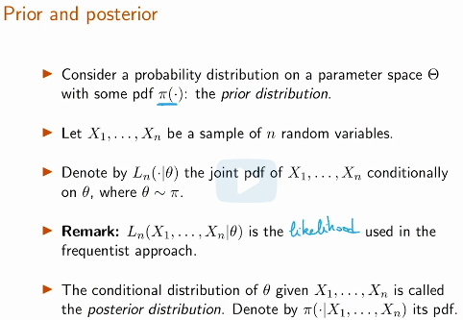
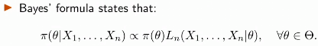
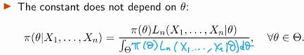
The Posterior Distribution, Bayes' Formula
a

Slide 12
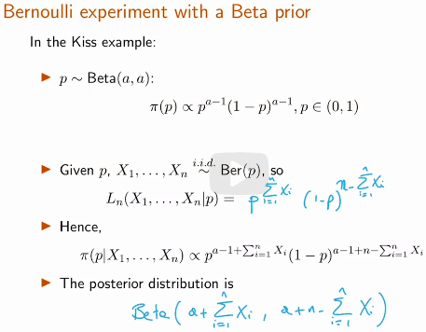
Application: Bernoulli Experiment with the Beta Prior
The main power of Bayesian approach comes from the fact that, designer can reflect the prior information in terms of a cleverly-engineered prior distribution.
Basically, you are multiplying the Likelihood and Prior distribution to get the Posterior, and there are a lot of constant term. You can keep all of them and get the final posterior. However, throwing the
constant term at each step, finally when
you get the Posterior without the constant
term, you could figure out the what the
constant term should be because the
posterior distribution should integrate to 1.
So there is no need to keep them
through the computation, it would be messy If
keeping all of them. And I think maybe finally, what we want is to maximize the posterior probability and not the whole distribution, so we don't really need them.

Slide 13
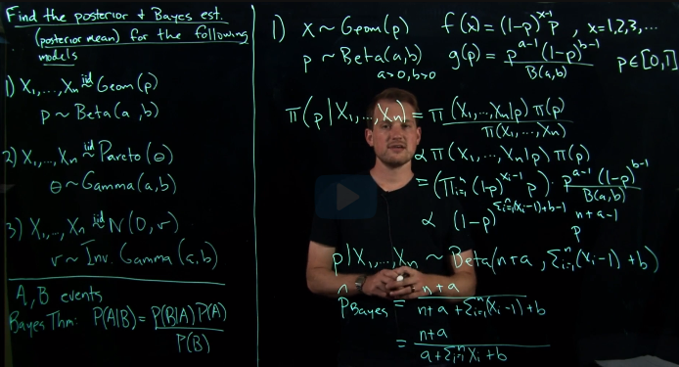
Recitation 20. Calculating Bayes posteriors
Bayesian estimation procedure: 1) Assume data follows some distribution 2) Assume some prior for the parameter of interest 3) Use Bayes rule to calculate posterior, drop the constants
So, in this example we wrote out likelihood and prior, got posterior and the family of distrib

Slide 14
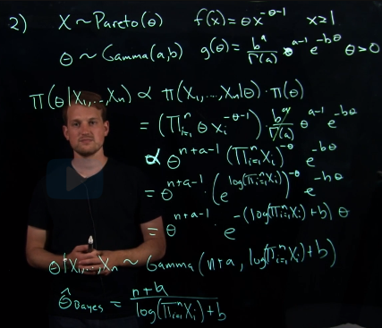
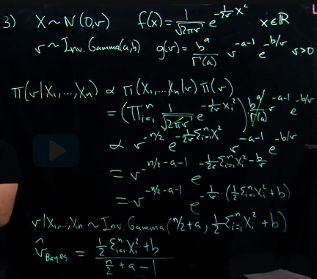
Recitation 20. Calculating Bayes posteriors
2 other examples

Slide 15
Lecture 18: Jeffreys Prior and Bayesian Confidence Interval
Bayesian Statistics Part 2
At the end of this lecture, you will be able to do the following:
Explain the important factors involved in choosing a prior distribution.
Distinguish between conjugate priors and non-conjugate priors .
Compute Jeffreys Prior and understand the intuition behind its significance.
Apply Bayesian statistics in simple estimation and inference problems.
Compare and contrast results from Bayesian and frequentist statistical methods.

Slide 16
Review
In frequentist approach we had a model (say data is generated by Gaussian process) and then we maximized likelihood under this model choice
In Bayesian approach on top of likelihood we need to pick a prior and then posterior depends both on prior and likelihood
In Bayesian approach instead of single estimate and confidence interval around it we get distribution, so we can construct any interval we wish
Deciding on the statistical model for the likelihood function is a separate step as specifying a prior distribution
Factors in Determining the Prior:
1. Whether or not we could specify the parameters of the distribution so that its shape approximates our prior belief (family of distributions has to be flexible enough so that we could find suitable parameters for the prior distribution to resemble the prior belief.)
2. Whether or not the support of the distribution is realistic based on our context (posterior must not have parameter values that are by definition impossible)
3. How tractable it would be to compute the posterior distribution and perform inference from it, given the form of the likelihood function (As seen in the previous lecture, one useful feature of the Beta distribution is that combining the prior and likelihood does not introduce any new terms; rather, we only need to update the exponents. In general, having a convenient or common posterior distribution would make it more feasible to come up with closed forms for certain inference tasks based on the posterior.)

Slide 17
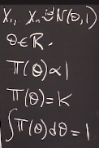
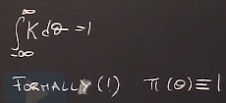
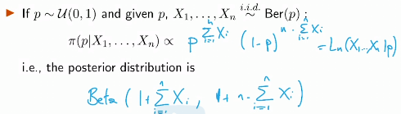
Choosing a Prior
We can still use a Bayesian approach if we have no prior information
About the parameter
Good candidate is that is constant PDF on every value of theta
If theta is bounded, this is the uniform prior on theta
If theta is unbounded, this does not define a proper pdf on theta (pi==0)
An improper prior on theta is measurable, non-negative function pi, defined
On theta that is not integrable
In general one can still use posterior distribution using improper prior,
Then posterior is proportional to likelihood, just rescale it so that it is PDF
Example

Slide 18
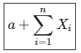
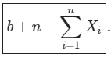
Beta distribution
Beta family of distributions is especially suited for the Bayesian framework because 1) it covers a large variety of distribution shapes, 2) only uses two parameters, and 3) simplifies computation as updates may be done by simple addition to the parameters.
Posterior a= b= when observations are Bernoulli’s
Which of these will result into the posterior distribution being a Beta distribution if we using different prior than beta, when likelihood is Ber(p) – support should be real and over [0,1]

Slide 19
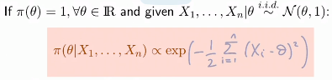
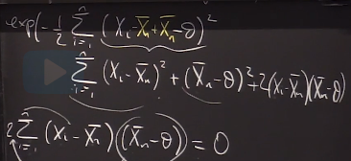
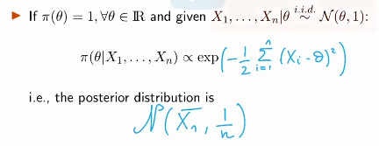
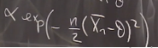
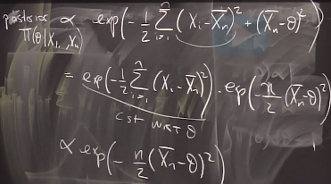
Improper Prior: Example
Using improper prior for Gaussian process

Slide 20
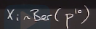
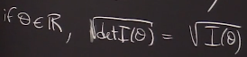
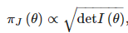
Jeffreys Prior
In uniform prior we do not know whether we should assign
Uniform prior to p or p^10, but if we use Jeffreys Prior it does not matter
Jeffreys prior is proportional to Fisher information
Recall that if Fisher information is high we have low variance for MLE
We say points with high Fisher info are easier to estimate, and we put more prior on those guys and determinant is just a way to collapse all these info into 1 number
Jeffreys Prior is an attempt to incorporate frequentist ideas of likelihood in the Bayesian framework, as well as an example of a non-informative prior. This prior depends on the statistical model used for the observation data and the likelihood function. Mathematically, it is the prior pi(theta)
The Fisher information matrix I here is treated as a linear transformation matrix which maps one coordinate space to another (the logic behind such a mapping would be explained soon). In linear transformation terms, taking the determinant represents the ratio of volumes of corresponding spaces between coordinate system, which explains the intuition behind the use of det(I)

Slide 21
Jeffreys prior
Suppose that you and a friend are analyzing the same set of data using a normal model. You adopt the usual parameterization of the normal model using the mean and the variance as parameters, but your friend prefers to parameterize the normal model with the coefficient of variation and the precision as parameters (which is perfectly "legal"). If both of you use Jeffreys' priors, your posterior distribution will be your friend's posterior distribution properly transformed from his parameterization to yours. It is in this sense that the Jeffreys' prior is "invariant“
Jeffreys prior where I(theta) is the Fisher information matrix of the statistical model (if we have single parameter then it is just a number)
It has the key feature that it is invariant under a change of coordinates for the parameter vector theta
That is, the relative probability assigned to a volume of a probability space using a Jeffreys prior will be the same regardless of the parameterization used to define the Jeffreys prior. it must be the case that, no matter which parameterizations we arbitrarily choose to start with, our posteriors should "match" after transformation.

Slide 22
Jeffreys prior
Jeffreys prior gives more weight to values of theta whose MLE estimate has less uncertainty. Fisher information is high, the MLE variance is low and thus the MLE has less uncertainty. Also from equation ~ sqrt(I)
Continuing from the above reasoning, when the MLE estimate has less uncertainty and we are able to estimate it more precisely. This corresponds to the data giving more information about the parameter when the Jeffreys prior yields larger values.
The Fisher information can be taken as a proxy for how much, at a particular parameter value would equivalent shifts to the parameter influence the data
Jeffreys prior gives more weight to regions with high Fisher informations. By the given interpretation for the Fisher information, this means that at these areas, a small change to theta will influence the data relatively more, or in other words, potential outcomes are more sensitive to slight changes in theta

Slide 23
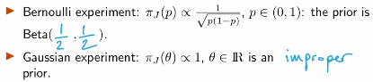
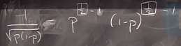
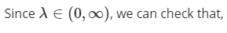
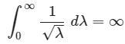
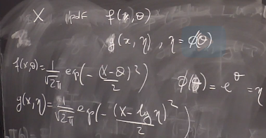
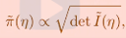
Jeffreys Prior II: Examples
A
Proper priors need to integrate to one over the values of parameter space
and therefore, Jeffreys prior for this problem is improper.
Normally, when we transform the parameter of a mode, we should also transform the prior so that we use the same prior, but when we use Jeffreys Prior then it takes care of this, so that it is parametrization invariant
When finding new pdf based on transformed parameter, we just plug the transform func
Jeffreys prior satisfies a reparameterization invariance
Principle if n is a reparameterization of theta
For some one-to-one map function, then

Slide 24
Reparametrization Invariance: Intuition
The Fisher information determines both the MLE asymptotic variance and Jeffreys prior, and as you've seen earlier it is a measure of how informative the prior is towards the data. It in fact measures the how detectable marginal movements of theta based on observations
This motivates the use of Jeffreys prior. The main motivation for using such a prior is because certain parametrizations may compress meaningful differences in theta into a small interval, whilst yielding large room for less impactful differences. In this case, a naive approach of using the uniform distribution would give an undue large weight to areas where modifying theta will not change the outcome much. Jeffreys prior directly adjusts for this through the Fisher information which is closely tied to MLE uncertainty.
This adjustment based on a quantitative measure of uncertainty facilitates accurate conversion between parametrizations. Scaling based on the square root of the Fisher information allows us to abstract from an artificial view imposed by a particular parametrization into a universal measuring stick of parameter impact. The distribution given by Jeffreys prior is based on this universal measure, independent of our parametrization. As a result, regardless of the parametrization, Jeffreys prior would give the same distribution.

Slide 25
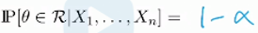
Bayesian Statistics for Inference
As in frequentist approach we had confidence intervals, we have CI in Bayesian case
However, they are not same, all the randomness in Bayesian CI comes from randomness in prior, so if posterior has no randomness, then probability would be 0 or 1
For alpha in range [0,1], a Bayesian conf. region with level alpha is a random subset R of the parameter space, which depends on the sample X1…Xn such that

Slide 26
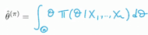
Bayesian estimation
Bayesian framework can also be used to estimate the true underlying parameter as in frequentist approach (parameter estimation)
We can use mean of posterior distribution or another popular choice would be the point that maximizes the posterior distribution, provided it is unique – MAP (maximum a posteriori)
We know that posterior=likelihood*prior, in frequentist approach we just used likelihood to estimate the parameter, in Bayesian method we weight the likelihood by its prior so the final probability of each theta is the product of its likelihood and prior probability
In general, the asymptotic properties of the Bayesian estimator do not depend on the choice of the prior, because at some point, there is so much data that it completely overwhelms the impact of the prior (so prior matters when we have very small samples

Slide 27
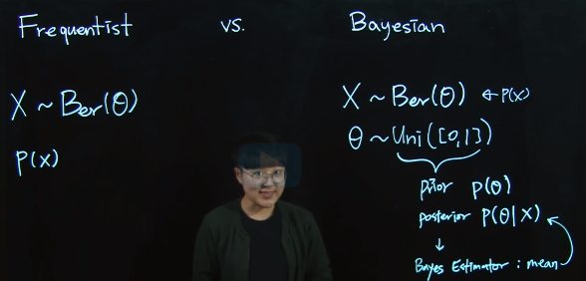
Recitation 21. Multinomial Bayesian Estimation
In Frequentist world, we assume some data generating function and we find parameter that maximizes the likelihood of data under such parameter, so the main tool here is distribution of data (PDF of Xi
In Bayesian world on top distribution for data we need to choose prior for theta (if data is huge, prior erodes), then combine them to compure posterior and at the end recognize the posterior distribution so that we can find its mean, median, quantiles etc

Slide 28
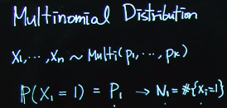
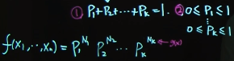
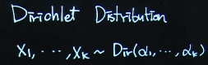
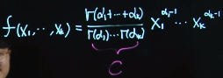
Recitation 21. Multinomial and Dirichlet distributions
Multinomial distr is a generalization of binomial distr where we have more (k) groups rather than 2, like we group N samples into k groups and pk is P(Ni be in k)
We can find probability of N of occurrences of 3 in 10 rolls of 6sided die
When k is 2 and n is 1, the multinomial distribution is the Bernoulli distribution. When k is 2 and n is bigger than 1, it is the binomial distribution. When k is bigger than 2 and n is 1, it is the categorical distribution
In probability and statistics, the Dirichlet distribution, denoted Dir( a ) is a family of continuous of multivariate probab distr parameterized by a vector a of positive reals. It is a multiva generalization of the beta distribution,^{[1]} hence its alternative name of multivar beta distribution (MBD).^{[2]} Dirichlet distributions are commonly used as prior distributions in Bayesian statistics, and in fact the Dirichlet distribution is the conjugate prior of the categorical distribution and multinomial distribution
The support of the Dirichlet distribution is the set of K-dimensional vectors x whose entries are real numbers in the interval (0,1) such that sum of the coordinates is equal to 1

Slide 29
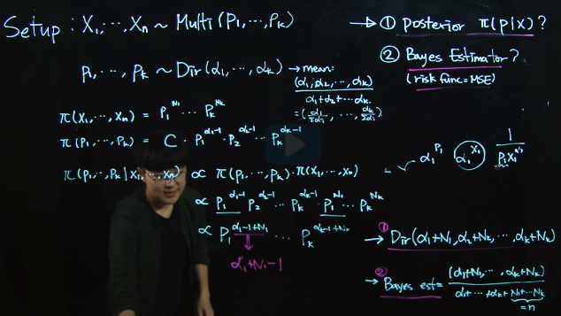
Recitation 21 Posterior calculation
So, procedure for Bayesian estimation, 1) take product of prior and likelihood, 2) then in posterior only keep relevant expressions that include parameter of interest 3) figure out posterior distribution of parameter and parameters of distr

Slide 30
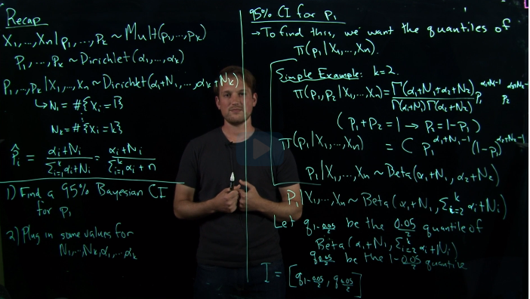
Recitation 21. Bayesian confidence interval
So, we got multivariate Dirichlet distribution as posterior, and now we want to find CI for one of its parameters, for that we replace other p’s with p1 and get single variable distribution and then get its quantile values for desired confidence interval region

Slide 31
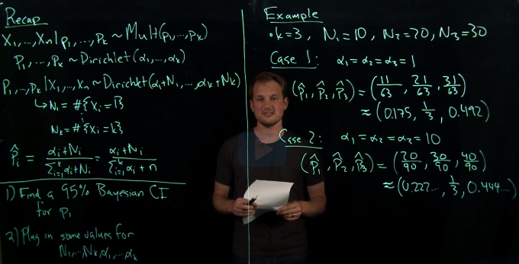
Recitation 21. Plugging real numbers
Here, we plug numbers to calculate numerical values for the estimates for the parameters p in Dirichlet distribution

Slide 32
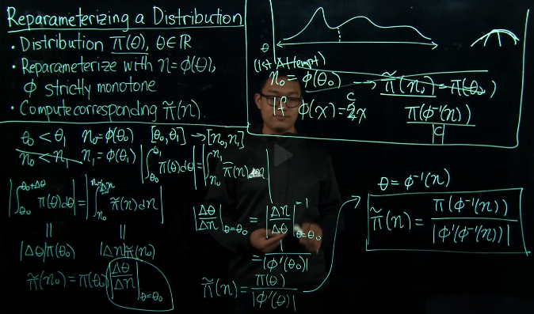
Jeffreys prior
Reparametrizing a distribution

Slide 33
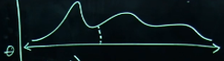
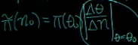
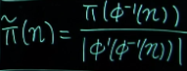
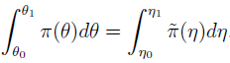
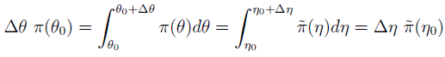
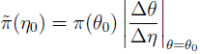
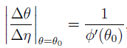


Reparametrizing a distribution
Suppose that we have a distribution with a continuous PMF over the variable . We
Reparametrize theta with a function to the variable Hence, we can define a distribution
For simplicity, assume that function is strictly monotonous and continuously differentiable. We wish to compute the reparametr distrib in terms of the old distribution and the new variable
Like we have some pdf for some parameter x, and we want to construct PDF for
Some function of f(x)=a, if we just assume that probability of x=5 equals to probability of a=10 (if a=2x), then this is wrong, because here we ignore the fact that our parameter space is transformed, for ex. if x[-5;5] then a[-10;10], we need to rescale new PDF
We can generalize this, by using the fact that
Interv probab for old and new PDFs should be same, by using this and incl possib of going in negat direc
If a=f(x); da=f’(x)dx; so dx/da=1/f’(x)

Slide 34
Intuition and MLE interpretation
Jefreys prior was designed to be a non-informative prior for the variable theta, that corresponds to a statistical model parametrized by theta
The notion of being non-informative, in an informal sense of the term, is to not prefer any value of the parameter over another. One might then think a uniform prior is the way to go.
But then, if we perform a reparameterization, the prior may no longer be uniform, so this breaks our 1st attempt of defining a non-informative prior
The Jefreys prior provides a resolution to this through its reparameterization invariance property, the proof of which is discussed in the next subsection.
The definition of the Jefreys prior in terms of the Fisher information relates the construction of the prior distribution to the likelihood function. In this subsection we discuss in more detail how this is accomplished, as well as how this is conceptually related to the frequentist concept of maximum likelihood estimation.

Slide 35


Choice of
Why we have chosen sqrt of FI, not another function? I^-0.5 is standard deviation of MLE, which characterizes uncert in estimate, radius of uncer and in the same units as theta
Inverse of Jeffreys prior I^-0.5 is a measure of uncertainty (std), if it is large then high uncertainty, if is large, then low uncertainty
We give less weight to theta’s whose fisher information is small (likelihood is small given this theta)
We give more weighting to theta’s whose I is large, so that they are informative priors
When we compare how much weight
should be given to theta at different locations
along the real line, we are somehow compare
how useful is the sample info at part loc,
One metric is by considering the radius
of uncert, and then weighting it by the inverse
of this radius. The reciprocal of the Jefreys prior weighting is a concrete measure of the radius of uncertainty of the MLE

Slide 36

Interpretation of I(theta) – Fisher information
1st definition is telling how sensitive on avg the likelihood
Or probability of data to particular value of theta (like how probability of data changes when we slightly change parameter value… square to account for neg/pos changes, so that we work with absolute changes, and Exp is for averaging for all points X
This is some metric of the effect of a marginal change of theta to the log likehood function as a whole, over the different possible values of Xi. Taking the expectation squared is also a common technique in statistics in order to account for both positive and negative changes.
We now consider which equals to like d^2E/d(0^2)=I, then multiply both sides by (delta(theta))^2 and get expected change in likelihood^2; if we keep RHS constant will be proportional to . For ex if we need twice as much change in theta to achieve the same effect to the log likelihood function amount of information is only half, meaning that is a measure of information compatible in scale with this distance interpretation
2nd definition (2nd derivative is about curvature in func), if the distrib is more curved, then it will be assigned higher Fisher info and thus higher Jeffreys prior weighting,-having quickly-changing likelih func for diff but close values of theta allows us to more accurately pin down correct value of theta from the samples, hence I (FI) is greater where marginal changes to theta has larger change to lik func, sim to 1st d

Slide 37


Sensitivity and the Jefreys prior weighting
In a statistical model different parametrizations may have different scales, and Fisher information relates different parametrizations
Jefreys prior converts a parametric distribution into a uniform form by taking sensitivity into account
In a reparameteriz from some variable to another corresponding distances are squeezed while some may be stretched, but regardless of these distances in the parameter line, they still represent the same change in the likelihood function.

Slide 38


Reparametrization Invariance Property
a

Slide 39

Recitation 22. Example
We have a statistical with some parameter, to compute Jeffreys prior for the parameter of a model, we compute its Fisher information and take its sqrt (this is direct method)

Slide 40

Recitation 22. Example
2nd way of computing Jeffreys priors

Slide 41
Overview of units 4 and 5
Unit 4: Hypothesis testing
Lecture 13: Chi Squared Distribution, T-test
Lecture 14: Wald’s test, likelihood ratio test, implicit hypothesis test
Lecture 15: Goodness of Fit Test for discrete distributions
Lecture 16: Goodness of Fit Tests Continued: Kolgomorov - Smirnov test, Kolgomorov – Lilliefors test, Quantile-Quantile plots
Unit 5: Bayesian statistics
Lecture 17: Introduction to Bayesian Statistics
Lecture 18: Jeffreys Prior and Bayesian Confidence Interval

Slide 42



Unit 4 review
Hypothesis testing terminology: 1) H0 and Ha 2) type 1 and type 2 errors 3) level (alpha) and power (1-alpha) of a test 4) p-values and our tests were based on CLT, so were asympt, key laws were CLT, LLN and Slutsky’s theorem (sample var -> var, when n large)
Now, we want to talk about cases when sample size is small – non asymp tests, if n<30, we cannot use Slutsky, so when we use sample var instead of var, then we get t-distrib
Xd (Chi-sq) distrib with d degrees of freedom (sum of squares of d standard normal r.v.) with mean=d, variance=2d
3rd moment-skewness (0 if sym); 4th moment – kurtosis (heaviness of tails; for Z -> 3)
Cochran’s theorem – if X1…Xn are gaussian then sample mean and sample var – indep for all n’s, and
For one sample t-test, the number of deg of freedom for t distrib is n-1, for 2-sided we use WS equation, it should be min(n,m) < Nws < n+m
Adv: of student’s test: non-asympt, works when n-small; disadv: requires Xi- gaussian
Wald’s test for multidim parameter vector hyp. Test test is based on MLE, If estimator is consistent, we can plug both true and MLE theta

Slide 43




Unit 4 review
We said theta_MLE is close to theta_0 then the length of difference vector should be small (to find length we should find its norm
Wald’s test is about the length of this vector
Likelihood ratio test:
Above is implicit multid hypot test, in a way that hypothesis tells us g(theta) not theta
Likelihood ratio test L(H1)/L(Ho) >c , we take log of both sides and multiply by 2
Tests covered: 1) t-test (small sample, unknown variance, gaussian) 2) Wald’s test (multidimensional parameters, based on MLE, square MLE) 3) Likelihood ratio test (ratio of H1 to H0/ 2*diff of log likelihoods – chi-sq distrib dim of par as deg of fred 2) 4) Implicit hypothesis test (we are given info about g(theta0) not theta_0 itself)
5) Kolgomorov-Smirnov 6) Kolgomorov-Lilliefors 7) QQ

Slide 44




Unit 4 review
Goodness of fit tests are non-parametric tests (Ha is everything else), e.g. H0 - X’s are i.i.d N(0,1), U(0,1) or PMF p1=0.3, p2=0.5, p3=0.2 (2-way table vs H0 proportions)
Question of interest is: Is this dataset drawn from a given distribution?
In parametric hypothesis testing we set H0 to some particular distribution in the family of certain prob distrib, so we limit what altern distrib can be, but in non-param (goodness of fit tests) we do not impose any limit
Basically to do goodness of fit test for PMF, we need to do hypothesis testing on vector-valued parameter, we can use Wald’s test (based on MLE), LR test (based on lik)
New distributions: categorical (more than 2 categories vs Bernoulli), multinomial vs binomial; likelihood of multinomial p_MLE:
Multinomial vs categorical
So for HT we can use MLE asymp normal, k-1 deg of F, as p’s sum to 1, thus not independent

Slide 45




Unit 4 review
Now if we square this and plug 1/var (1/(p*(1-p)) instead of FI, we get
We divide by p not p(1-p) (we get lower value of test statistics, more conservative)
Chi-sq vs Wald’s test; in Wald’s test elem of vec p are indep
Chi-square test is used to determine whether there is a statistically significant difference between the expected frequencies and the obs. frequencies in contingency table, Wald’s test is based on MLE to do hypothesis testing on param that are represented by a vector
Chi-sq
N is number of data points, d-dim of par; K+1 support
If we apply Wald’s test to HT param of categorical stat model
As sum of pi’s is 1, FI matrix would not be invertible, instead we use k-1 dim. Vector p, and apply Wald’s test and it turns out to be Chi-sq test (we need p^, I(p^))
New terminology: 1) empirical CDF 2) Kolgomorov-Smirnov 3) Kolgomorov-Lilliefors 4) QQ

Slide 46





Unit 4 review
Goodness of fit test (non-parametric) – data either comes from partic distrib or not
In discrete case (p=p0) we use Chi-sq test with k-1 deg Freedom; in contin case pdf instead of pmf, chi-sq does not work – becomes parametric test with inf deg of freed.
One option is to convert PDF into PMF by introducing bins and use Chi-sq test
Empirical CDF cdf fully character distr of X
Having found a way to estimate CDF by emp CDF, we want to measure how close the true and empirical CDFs are and what are fluct of distance given some number of obs.
Empirical CDF is consist estim of CDF, because by LLN E[X] and E[X] -> to CDF
Glivenko-Cantinelli theorem guarantees consistence
Fn is average of Bern. rand var. here variance is a func of t
Donsker’s theorem: uniform CLT; we can look q_alpha in tables
So, in discrete case we use Chi-sq, in contin Kolg-Smirnov
So, we should find sup, worst case t in R (comput hard), sup can only be achiev at obs points

Slide 47





Unit 4 review
Sup is only ach at obs points, per each points 2 discr to check
So, in practice we compute Tn
As we can use
Then where or t=F^-1(x)
Inverse transform sampling: U=F(x); we randomly sample from uniform then F(x)=0.5
Then we use x=F^-1(0.5) to get quantile, F should be invertible
Kolgomorov-Lilliefors test- we use this test in cases when we do not know the true values of parameters, but we use estimators for those values, then they become biased and closer, so we need more convservative (lower) quantiles (everything is same as in KS test, but different quantiles to compare the Tn with)
QQ plot compared to earlier tests, which were based on test statistics and p-values, is a visual test, to test whether a particular distribution is close to another distribution
We can also use histograms, PDFs, CDFs, but using those it is hard to see departures
We use qq plots when N of obs is small (<50), if N is large, we can use t-test or KS

Slide 48
Unit 5 review
Bayesian interpretation of probability is degree of belief in an event, degree of belief can be based on prior knowledge, previous experiments, this is different to frequentist interpret. that views probability as limit of relative freq of an event after many trials
Bayesian methods use Bayes’ theorem to compute and update probabilities after obtaining new data, thus it allows to update probabilities using new info/data, computation is similar to freq case when doing inference, we just multiply by priors
In classical inference, model parameters and hypotheses are considered to be fixed, however, in Bayesian setting, probabilities are assigned to parameters (par are r.v.)
In Bayesian setting, on top of assuming data generating model, prior distributions should also be assigned, also parameters of distributions of prior, may themselves be assigned priors, leading to Bayesian hierarchical modeling, or priors may be interrelated, leading to Bayesian networks. Bayesian is the most effective when we have a lot of prior knowledge
A Bayesian network, is a probabilistic graphical model (a type of statistical model) that represents a set of variables and their conditional dependencies via a directed acyclic graph (DAG). Bayesian networks are ideal for taking an event that occurred and predicting the likelihood that any one of several possible known causes was the contributing factor.

Slide 49
Unit 5 review
Topic essentials: 1) Bayesian approach 2) choosing prior 3) Conjugate, non-conjugate priors 4) Jeffreys Prior, its intuition 5) Bayesian inference 6) Frequentist vs Bayesian methods
In Bayesian setting, we do not need to know a lot of tests, just priors, likelihood and posterior, but comput. more intensive (extra thing is prior), if we do not have much prior knowledge, we can use non-informat. priors, so that we can use Bayes t without having priors
In a sense, Bayesian inference amounts to having a likelihood function Ln(theta) that is weighted (vs equal weighting) by prior knowledge on what theta might be
Ways to incorporate our existing knowledge in frequentist approach 1) limit the set of possible values for parameter 2) choose more suitable probability model 3) choose more suitable procedure MLE, M-estimation or method of moments
Example: say we use Ber(p) for data, if we use frequentist approach we observe some data, find its mean and variance then normalize and construct CI, in Bayesian setting we may belief that p is likely to be close to 0.4 and incorporate this belief via priors (using beta distribution)
If posterior distribution is in the same family as prior, then prior is called conjugate prior
Ignore constants while using Bayes rule, at the end figure out distrib from PDF

Slide 50
Unit 5 review
Things we need to consider when choosing a prior:
1) whether we can reflect our knowledge with this prior (model is flexible enough, so that we can tweak parameters)
2) whether support of distribution is compatible (e.g. for Ber(p), should be in [0,1] )
3) easy of computation – compatibility of prior and likelihood
If we have no prior info we can use non-informative prior: improper (constant value) – does not integrate to 1; then posterior will have same form as likelihood
Jeffreys Prior is an attempt to incorporate frequentist ideas of likelihood in Bayesian framework, as well as idea of non-informative prior, here our choice for prior depends on observational data that is
Jeffreys prior has idea of invariance of parameterization, so does not matter if parametrize parameter as p or p^10 as long as it is same distribution
As JP is prop to FI, FI is high when var is low, so we put more weight to points that are easier to estimate (high FI)
When data becomes large, MLE and Bayesian approaches yield similar values as at some point data becomes so huge that it overwhelms the impact of prior

Slide 51
Unit 5 review
When Fisher information is high, the MLE variance is low , then the MLE estimate has less uncertainty, we are able to estimate it more precisely, this corresponds to the data giving more information about the parameter when the Jeffreys prior yields larger values.
The Fisher information can be taken as a proxy for how much, at a particular parameter value would equivalent shifts to the parameter influences the data
By the given interpretation for the Fisher information, this means that at these areas, a small change to theta will influence the data relatively more, or in other words, potential outcomes are more sensitive to slight changes in theta
For example if data is generated by Ber process then prior is
So, using Jeffreys priors we can consider only the data while selecting prior
This adjustment based on a quantitative measure of uncertainty facilitates accurate conversion between parametrizations, so scaling based on the square root of the Fisher information allows us to abstract from an artificial view imposed by a particular parametrization into a universal measuring stick of parameter impact.
All the randomness in Bayesian CI comes from randomness in prior, so if posterior has no randomness, then probability would be 0 or 1

Slide 52

Insights from exercises
When n goes to infinity effect of prior in Bayesian posterior vanishes, so it becomes very close to likelihood, that is to MLE estimator
For U[0;theta] MLE is Xmax, and it is on the boundary. all the theorems establishing the asymptotic normality of the MLE require the satisfaction of some "regularity conditions" in addition to uniqueness. Roughly speaking, these regularity conditions require that the MLE was obtained as a stationary point of the likelihood function (not at a boundary point), and that the derivatives of the likelihood function at this point exist up to a sufficiently large order that you can take a reasonable Taylor approximation to it.
In the case of the MLE of the uniform distribution, the MLE occurs at a "boundary point" of the likelihood function, so the "regularity conditions" required for theorems asserting asymptotic normality do not hold. So far as I am aware, the MLE does not converge in distribution to the normal in this case.

Slide 53

Midterm 2 insights
ALL

